Slide 1
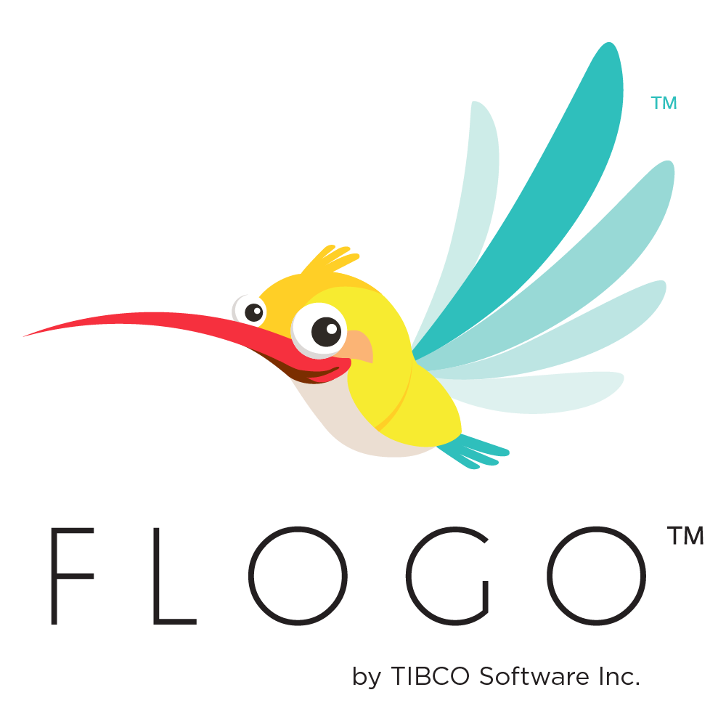
TIBCO FLOGO
Training Day 3
Trainer: Jaydeep
Date: 07/Jul/2023

Slide 2
Agenda
Triggers and Extensions
Triggers
Program Contents
Receive HTTP Message (REST) Trigger
Other Triggers
Flow Inputs & Outputs
Extensions
Extensions and Import
Flows
Branching
Error Branches
Subflows
Tips on Subflows
Iteration
Return Activity
Application-level Schema
Use App-level Schema
Coerce Parameters

Slide 3
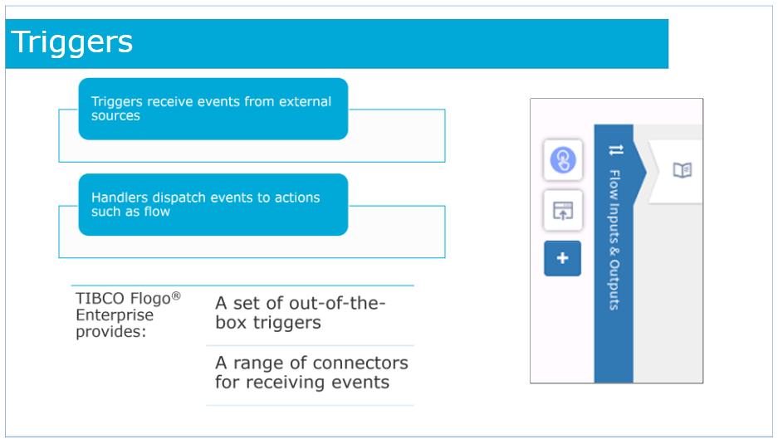
Triggers
Triggers receive events from external sources such as Kafka, Salesforce, GraphQL and so on.
Handlers dispatch events to actions such as flow.
Flogo Enterprise provides a set of out-of-the-box triggers as well as a range of connectors for receiving events from a variety of external systems.

Slide 4
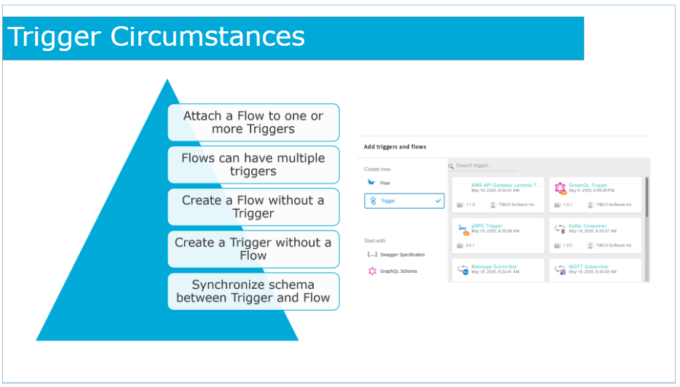
Trigger Circumstances
If you had created a blank flow without attaching it to a trigger, you can attach it to an existing trigger that is being used by another flow in the same app. If you are unsure of the circumstances under which the flow should be activated or if you want the flow to be activated under more than one situation, use the Configure flow inputs and outputs and add the trigger(s) at a later time as needed to the flow.
A flow can have multiple triggers. When executing a flow with multiple triggers, you cannot disable a trigger, specify a particular trigger to execute, or specify the order in which the triggers execute. All triggers get initialized in the order that they appear in the flow.
You have the option to either create a trigger as a part of the process of creating a flow or you can create a trigger without creating a flow.
When creating a flow in the Flogo App, you can create it without a trigger. This method of creating a flow is useful when the logic for the flow is available but you do not know just yet what action should activate the flow.
You can start by creating a flow with the logic and attach one or more triggers to the flow at a later time.
You have the option to either create a trigger as a part of the process of creating a flow or you can create a trigger without creating a flow.
If you make any changes to the schema that you entered when creating the trigger, you must save any changes you make explicitly then you must propagate the changes to the flow input and flow output.

Slide 5
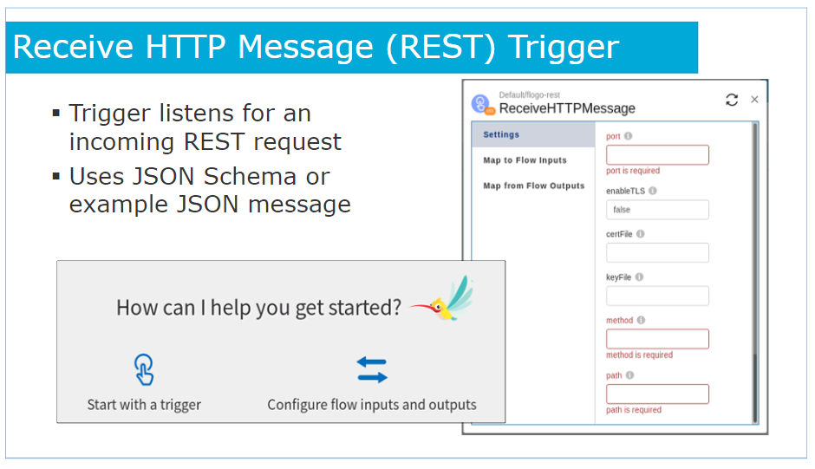
Receive HTTP Message Trigger
When creating a flow with a REST trigger, you have the option to either enter the schema in the Add a trigger dialog while creating the flow or you can start by using a Swagger-compliant JSON file to create the flow.
A flow can have multiple REST triggers.
Two REST triggers cannot have an identical port, path, and method combination.
Each REST trigger needs to differ from the other REST triggers for the same flow with either a unique port, path, or operation (GET, PUT, POST, DELETE).

Slide 6
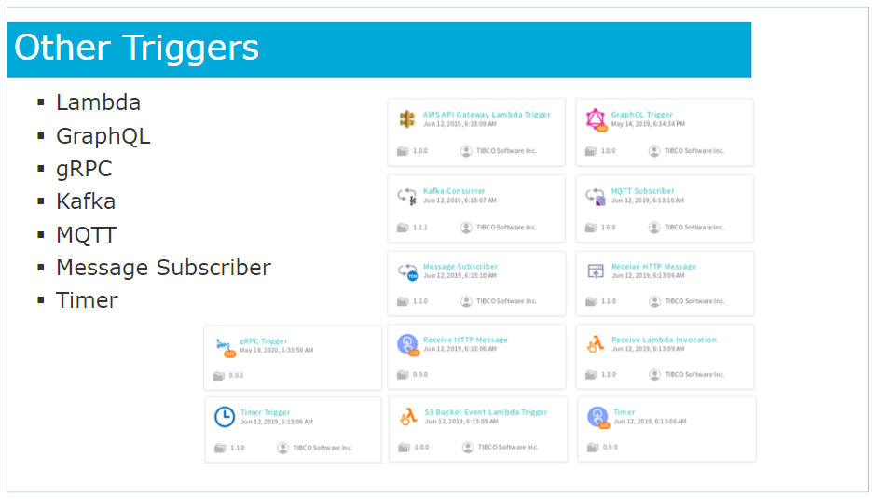
Other Triggers
Here are some other triggers available by default in Flogo.

Slide 7
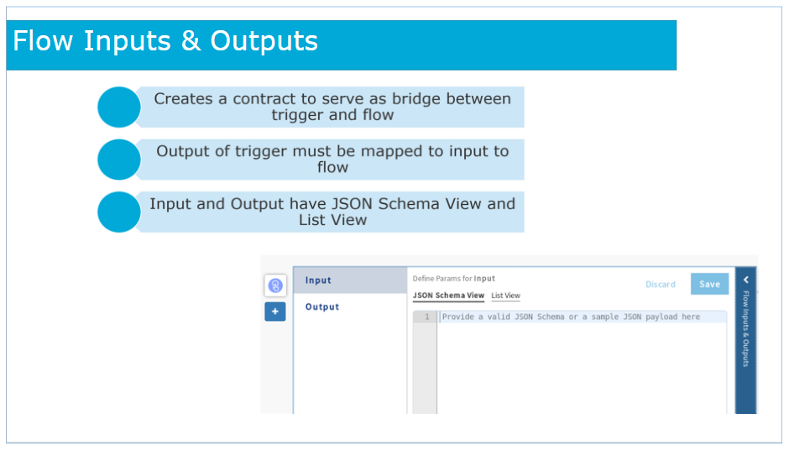
Flow Inputs & Outputs
The Flow Inputs & Outputs allows mapping of the elements from the trigger output to flow input elements, such that the trigger output feeds into the flow input.
A flow that was created without a trigger has its input and output parameters defined in the Flow Inputs & Outputs dialog that you can access by clicking the blue bar with the same label.
You must map the input parameters defined in the Input tab of this dialog to the trigger output parameters. This mapping must be done in the trigger. The mapping creates a contract between the trigger and the flow.
This contract is mandatory, since the flow and the trigger were developed independent of each other and must now interact with each other.

Slide 8
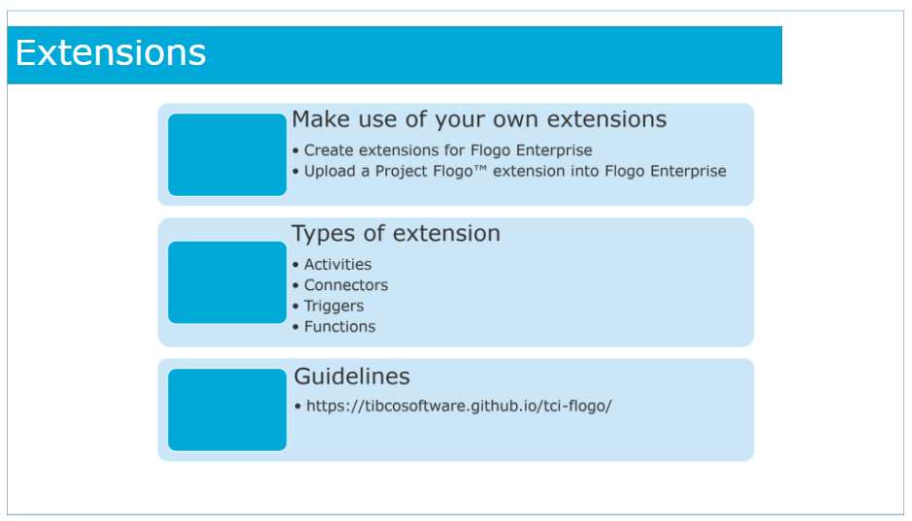
Extensions
Flogo gives you the ability to make use of your own extensions.
You can create and contribute the following types of extensions:
activities
triggers (you can define custom triggers that you can upload and use to create a flow)
connectors (a connector provides configuration details to connect external apps, for example, Salesforce )
functions (to be used inside the Mapper when mapping elements)
The extension you upload must follow the guidelines found on the GitHub page:
https://tibcosoftware.github.io/tci-flogo/

Slide 9
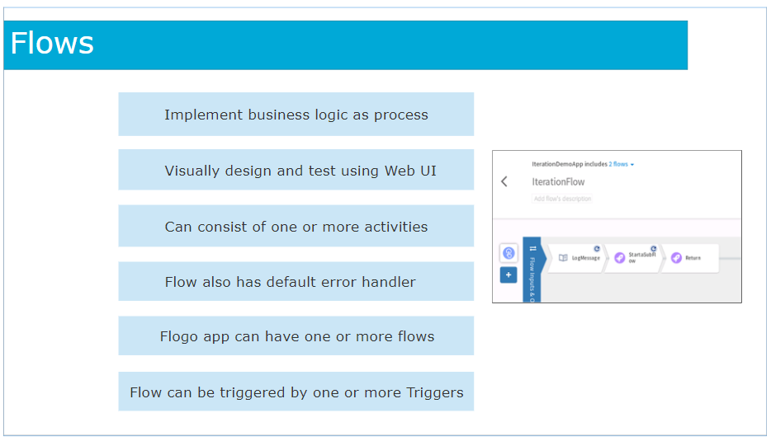
Flows
The Flogo ecosystem provides a set of actions for processing events in a manner suitable to your implementation logic.
The flow is one of the actions in Flogo that allows you to implement the business logic as a process.
Flows are visually designed and tested using the Web UI.
A flow can consist of one or more activities that perform a specific task.
Activities are linked and can contain conditional logic for branching.
Each flow also has a default error handler.
A Flogo app can have one or more flows.
A flow can be triggered by one or more Triggers within the application.

Slide 10
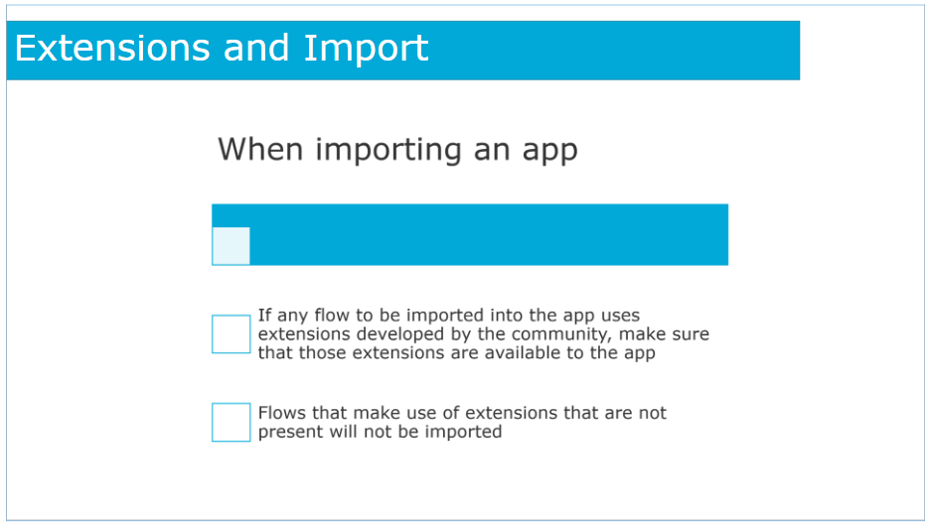
Extensions and Import
When importing an app, if any flow in the app uses extensions developed by the community, you need to make sure that those extensions are available to the app into which you are importing when importing.
Flows that make use of extensions that are not present will not be imported.

Slide 11
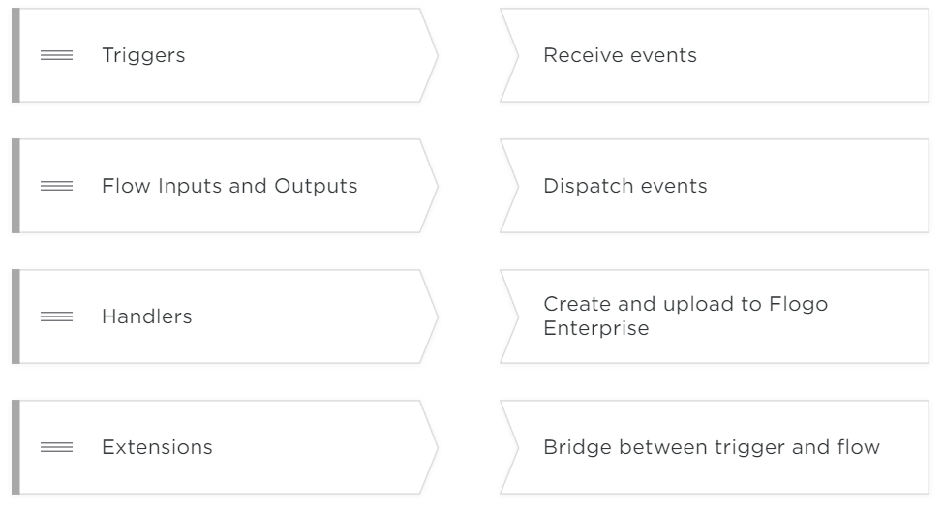
Check Your Knowledge

Slide 12
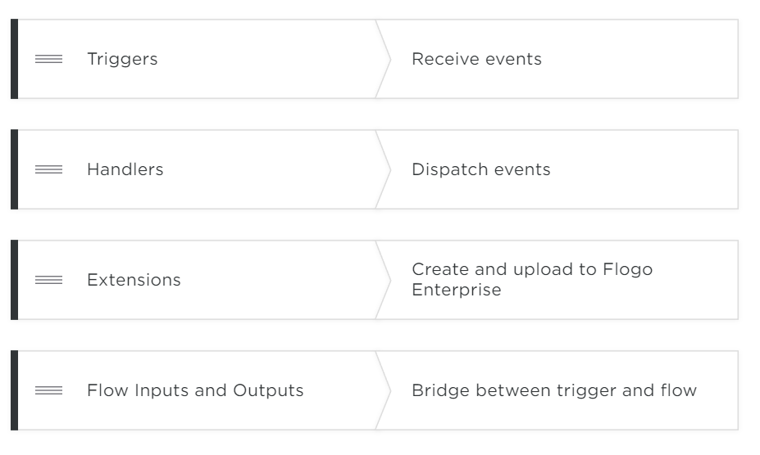

Slide 13
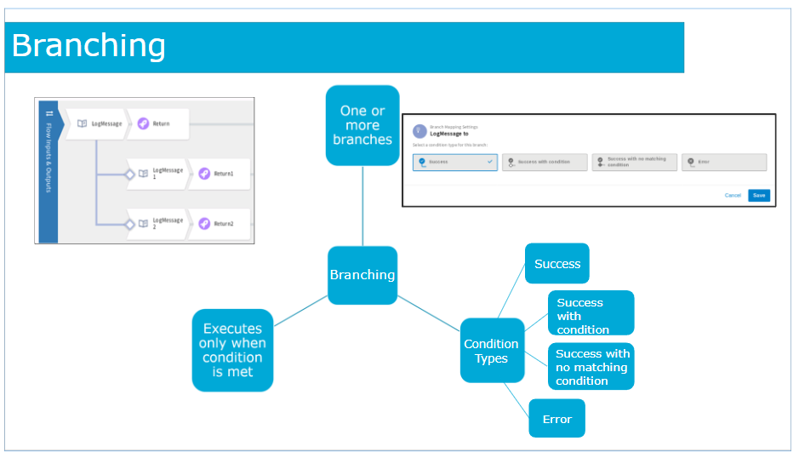
Branching
Activities in a flow can have one or more branches. If you specify a condition for a branch, the branch executes only when the condition is met.
You must select one of the following conditions during branch creation:
A success branch gets executed whenever an activity executes successfully. If there is an error in the activity execution, this branch does not execute. The branch has no conditions set in it.
Select Success with condition
If you want a branch to execute only when a particular condition is met. If you select this condition and do not provide the condition, the branch never gets executed.
Success with no matching condition
This branch condition is displayed only when you already have an existing Success with condition branch.
Or Error
A branch with this condition executes if there are errors in the execution of the activity. An activity can have only one Error branch.

Slide 14
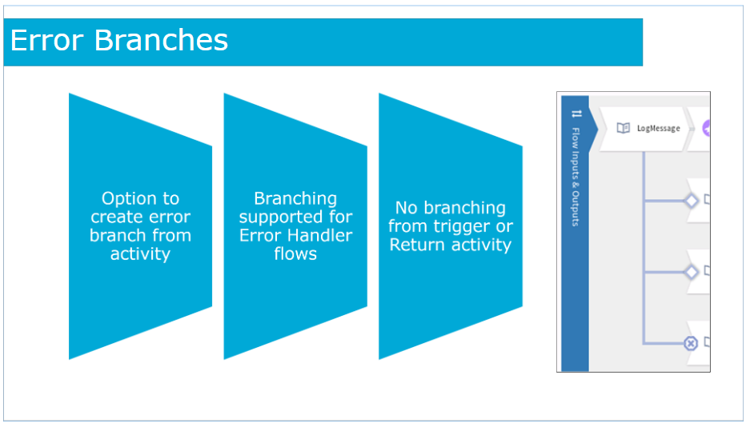
Error Branches
The purpose of the error branch is to catch any errors that might occur during the execution of the activity.
Branching is also supported for Error Handler flows, which serve the purpose of catching all errors at the flow level.
You cannot create a branch from a trigger or a Return activity.

Slide 15
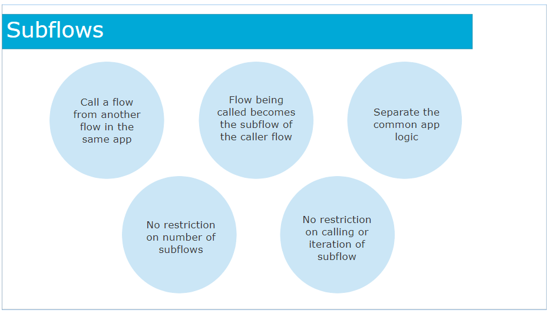
Subflows
TIBCO Flogo Enterprise provides the ability to call any flow from another flow in the same app.
The flow being called becomes the subflow of the caller flow. This helps in separating the common app logic by extracting the reusable components in the app and creating standalone flows for them within the app.
Any flow in the app can become a subflow for another flow within the same app.
Also, there are no restrictions on how many subflows a flow can have or how many times the same subflow can be called or iterated in another flow.
Hence, subflows are useful when you want to iterate a piece of application logic more than once or have the same piece of logic repeat in multiple locations within the app.

Slide 16
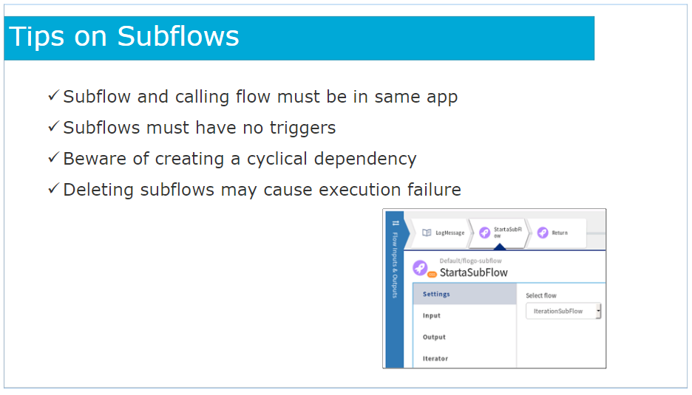
Tips on Subflow
The subflow and its calling flow must both reside within the same app. You cannot call a flow from another app as a subflow in your app.
Subflows must be blank flows (flows without triggers). Flows starting with a trigger are not supported as subflows because flows created with triggers do not have flow inputs and outputs configured. The trigger input and output act as the flow input and output for flows created with a trigger. Hence, there is no bridge to connect the subflow to the Start a SubFlow activity in the calling flow.
Since you can call any flow from any other flow within the app, you must be careful not to create cyclical dependency where a flow calls a subflow and the subflow in turn calls its calling flow. This will result in an infinite calling cycle and you will receive an error "Cyclic dependency detected in the subflow".
You can delete any flow in an app even though the flow might be in use as a subflow within another flow. You will not receive any error messages at the time of deletion, but when you run the app, its exectution fails with an error.
You can configure the iteration details in the Iterator tab of the ’Start a SubFlow’ activity. The ’Start a SubFlow’ activity iterates multiple times, resulting in the subflow being called multiple times.

Slide 17
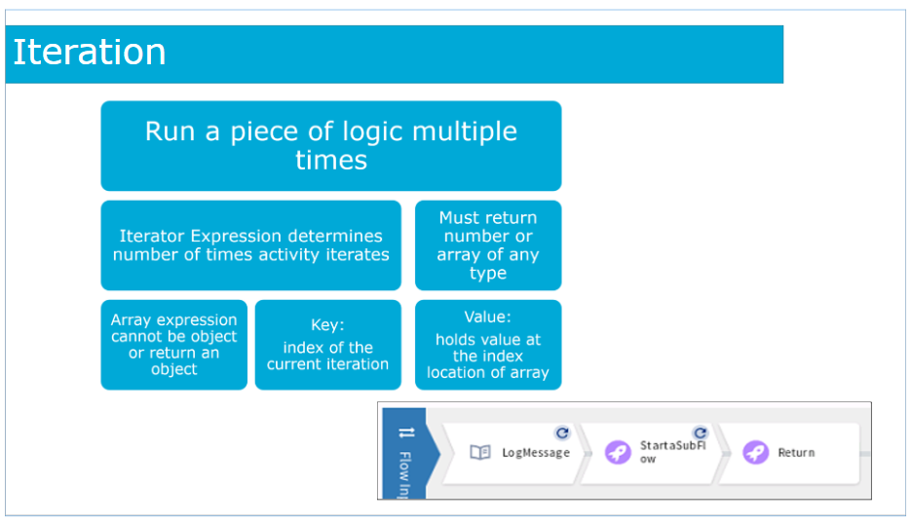
Iteration
When creating a flow, you may want to iterate a certain piece of logic multiple times.
Set the expression for the iterator by either entering the expression manually or mapping the output from the preceding activities or trigger. You can also use available functions along with the output from previous activities and/or manually entered values to form the iterator expression.
The iterator expression determines the number of times the activity iterates.
The iterator expression must either return a number or an array. The array can be of any data type. Currently, you cannot iterate through an object so the array expression cannot either be an object or return an object.
If your iterator expression returns a number, for example 3, your activity will iterate three times. If your iterator expression returns an array, the activity will iterate as many times as the length of the array.
Keep the following in mind when using the Iterator feature:
Iteration is supported for an activity only. You configure the iteration details in the Iterator tab of the activity.
There are certain activities that inherently do not require iteration, for example the Return activity whose purpose is to exit the flow execution and return data to the trigger. The Iterator tab is not available in such activities.
You cannot iterate through a trigger.
For apps that were created in Project Flogo™ and imported into Flogo® Enterprise, the key type in the Iterator tab is converted from string to relevant data type of value in Flogo® Enterprise.
After you enter the iterator expression, the iterator icon appears on the top right corner of the activity leaf.
If an activity has been set up for iteration, the Input tab of the activity displays the $iteration scope in the output area of the mapper. It contains two properties, key and value. key is used to hold the index of the current iteration and value holds the value that exists at the index location of the current iteration if the iterator expression evaluates to an array.

Slide 18
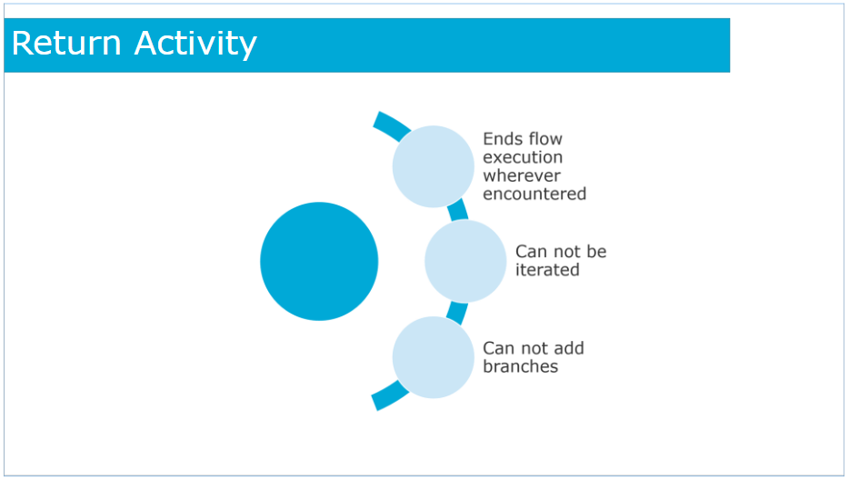
Return Activity
A Return activity ends the flow execution. So, regardless of whether the flow execution encounters a Return activity in a branch or at the end of the flow itself, as soon as the flow execution encounters a Return activity anywhere, it exits the flow.
The purpose of Return activity is to exit the flow execution and return data to the trigger. The Iterator tab is not available in such activities.
You cannot create a branch from a trigger or a Return activity.

Slide 19
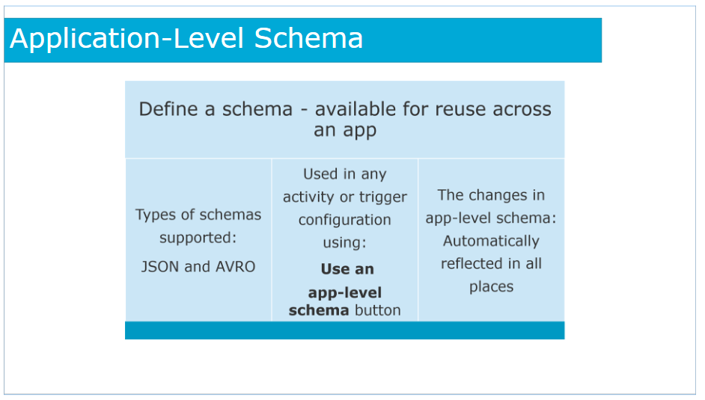
Application Level Schema
You can define a schema so that it is available for reuse across an app. Creating such an app-level schema saves you time and effort of entering the same schema multiple times; you can simply pick the schema from a list. An app-level schema can be used in any flow, activity, or trigger configuration where a schema editor is provided.
App-level schemas are filtered based on the type of the activity or trigger. For example, only JSON schemas are displayed in a REST trigger or activity configuration.
Types of schemas supported are JSON and AVRO.
After the schema is defined, it can be used in any activity or trigger configuration by using the Use an app-level schema button in the schema editor of the activity or trigger.
When you make changes to an app-level schema, the changes are automatically reflected in all places where the schema is used.
Deleting a schema removes its reference from all the places where it is used but it retains the schema values.
If there is change in the schema attached to a trigger, click Sync to synchronize it with the input/output of the flow.

Slide 20
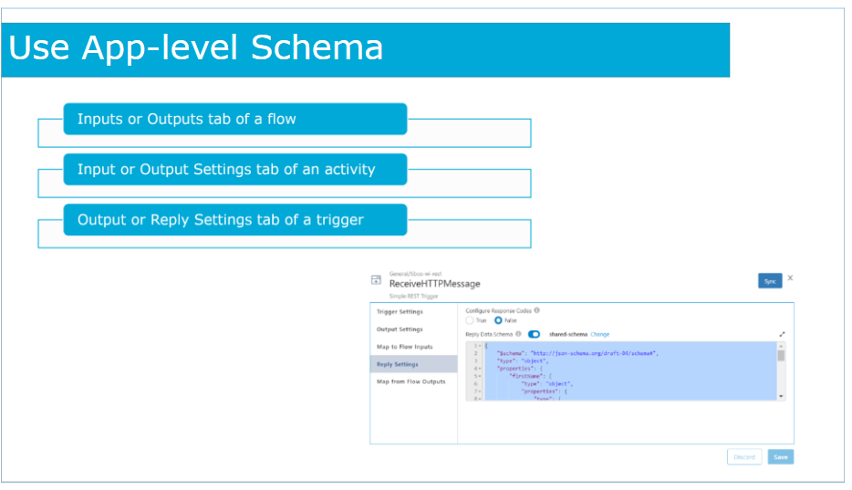
Use App Level Schema
You can use an app-level schema from a flow, trigger, or activity:
Inputs or Outputs tab of a flow:
Use these tabs to configure the input to the flow and the flow output. These tabs are particularly useful when you create blank flows that are not attached to any triggers.
Input or Output Settings Tab of an Activity:
When configuring an activity, you can select an app-level schema in the Input or Output Settings Tab of an activity.
Output or Reply Settings Tab of a Trigger:
When configuring a trigger, you can select an app-level schema in the Output or Reply Settings Tab of a trigger.

Slide 21
Coerce Parameters
In the activity input, output or trigger reply configuration, if you have defined a parameter, but have not defined or cannot define a schema for the parameter, you can coerce the parameter to take the value from a schema that you dynamically define during design time.
This feature is particularly useful for apps that were created in Project Flogo and imported to Flogo® Enterprise.
Such apps will likely have activities for which input parameters or output are not defined with a schema.
Currently, Flogo Enterprise supports coercing for parameters of the following data types:
array
object
param
any
Coercing is supported only in the Default category activities which are the activities marked as OSS, with the exception of the Return and Start a SubFlow activities.
After you enter the schema, it is displayed in a tree format under Activity Input, Output tab, or Trigger Reply in the mapper. All subsequent activities will also display the elements of the schema under the activity in the Upstream Output. The schema elements will now be available for you to map.

Slide 22
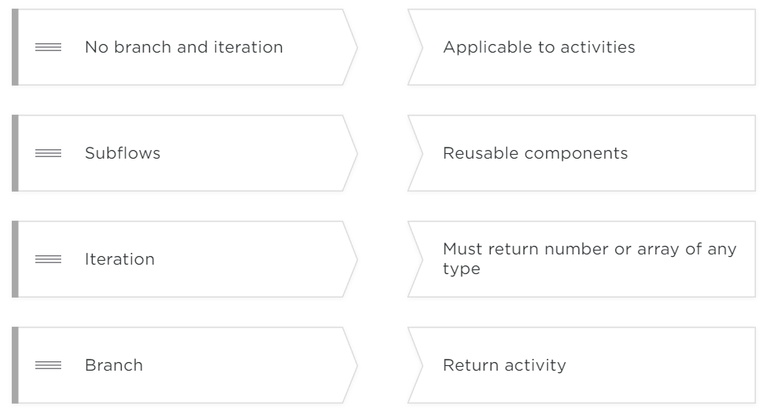
Check You Knowledge

Slide 23
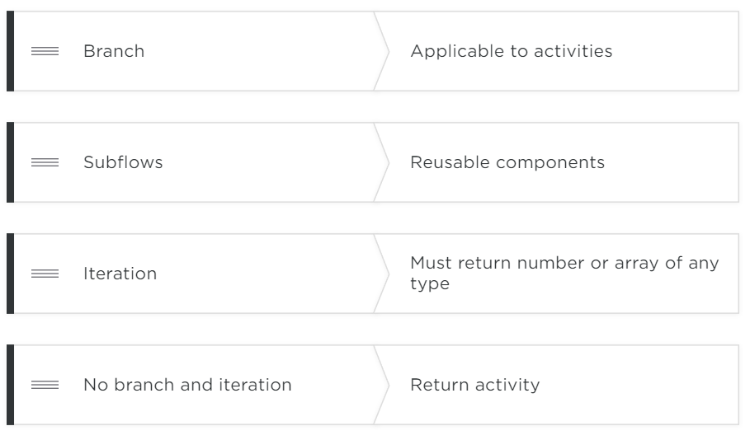

Slide 24
LAB
1. Branching
2.Use of subflow and app level schema
3.use of iteration and return activity
Custom Activity
github.com/retgits/flogo-components/activity/randomnumber

